Slide 1
NAVAIR Aircrew Systems Industry Day Perspectives
Presented by: Mr. Gary Kurtz,
Director, Common and Commercial Services
24 July 2019

Slide 2
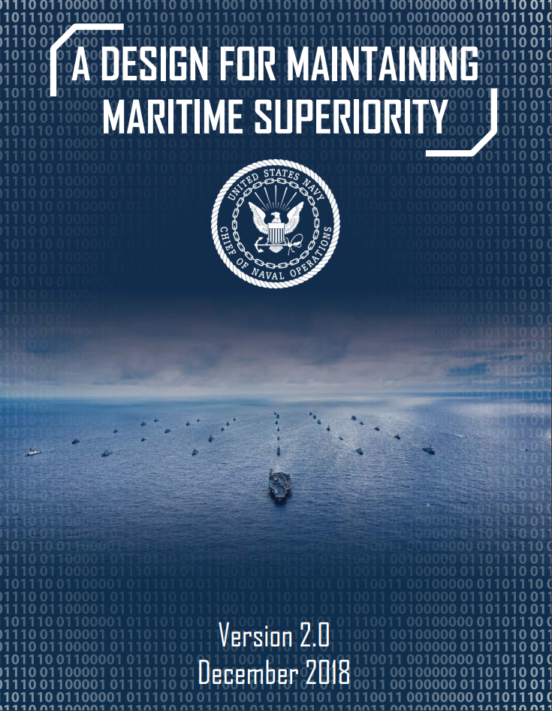
DOD / DON Strategic Intent
2018 National Defense Strategy - Strategic Approach
Build a More Lethal Force
Strengthen Alliances and Attract New Partners
Reform the Department for Greater Performance and Affordability
CNO’s Design for Maintaining Maritime Superiority
Strengthen Naval Power At and From The Sea
Achieve High Velocity Learning at Every Level
Strengthen Our Navy Team For the Future
Expand and Strengthen Our Network of Partners
Expand dialogue with industry partners, increase shared understanding, reduce obstacles to more effective & efficient ways of doing business

Slide 3
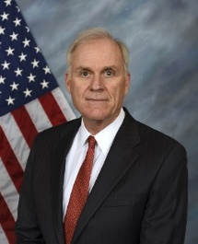
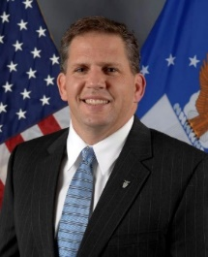
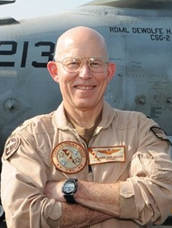
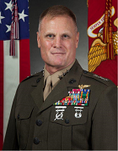
Navy Leadership Priorities
Secretary of Navy Richard Spencer
Priorities: People, Capabilities, Processes. We will drive efficiency, adopt and implement new ideas, and leverage leading practices from industry and academia to positively impact and support acquisition, manpower, research, and operational processes.
ASN(RD&A) Secretary James ‘Hondo’ Geurts
Primary cornerstones to acquisition purchasing - Reliability, Agility, Affordability. “I want to build everything as fast as we can.”
CNAF VADM DeWolfe Miller
Current Readiness - Improve aircraft availability and Full Mission Capable rates to meet training and warfighting demand.
Future Readiness – Capacity. Capability. Alignment. Accurately define requirements and influence full resourcing with accurate data and facts.
USMC DCA LtGen Steven Rudder
Top 4 priorities: 1. Focus on Readiness. 2. Modernization of the Forces – aircraft and systems. 3. Support the Maintainer – leadership, career path, incentives, tools. 4. MAGTF Integration – combined arms fight. The framework upon which to build tomorrow’s force.

Slide 4
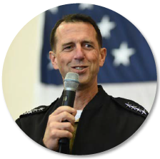
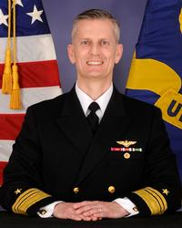
Strategic Imperatives
“We have got to move faster. We have got to learn faster. We’ve got to adjust our acquisition systems to adopt that technology faster…I need an acquisition system that will allow for quick technology refreshes to continuously improve performance, rather than relying on massive game changers every 20 years”
- CNO John Richardson
Deliver new Capabilities with Increased Speed.
Keystone Metric: On-time delivery of effective and sustainable systems. We will increase speed of capability delivery. Measure: Reduce acquisition cycle time by 10 percent each year.
- VADM G. Dean Peters

Slide 5
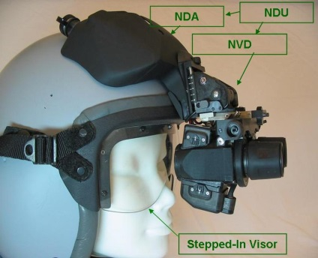
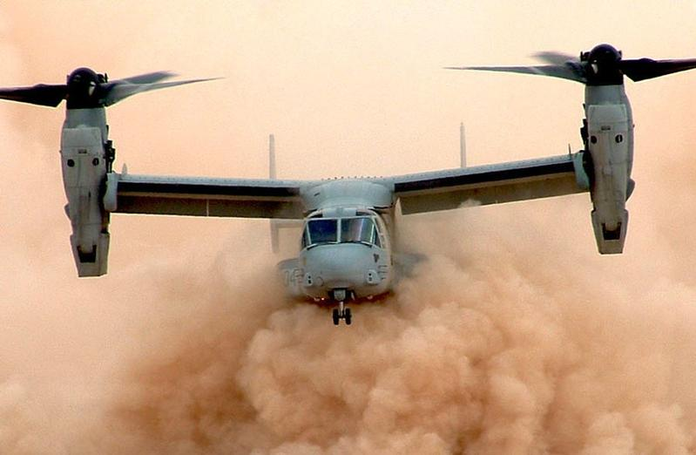
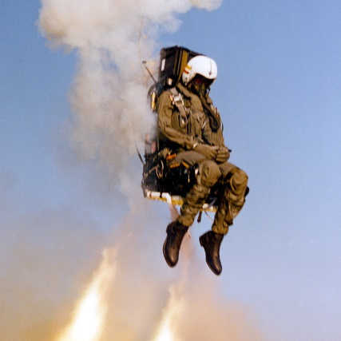
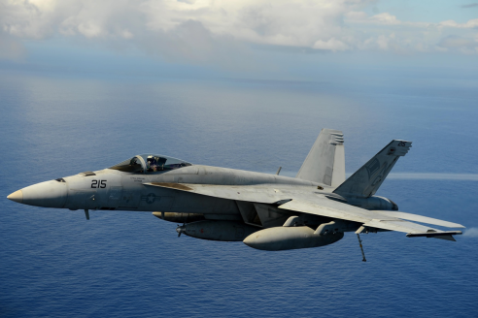
PMA-202 Aircrew Systems
Effective and affordable systems supporting aircrew and flight deck maintainer safety, survivability and mission enhancing core capabilities
Program Manager: Captain Tom Heck
Personnel Protection Equipment
Flight clothing & Anti-Exposure systems
Flight Deck Cranial & Hearing Protection
Chem Bio Joint Service Aircrew Mask
Combat Survivability
Oxygen Generation & System Enhancements
Laser Eye Protection
Performance Force Multipliers
Helmet Mounted Displays
Night Vision Enhancement Devices
Enhanced Visual Acuity
Escape, Egress, Evasion & Recovery
Navy Common Ejection Seat
Combat Survival Radio

Slide 6
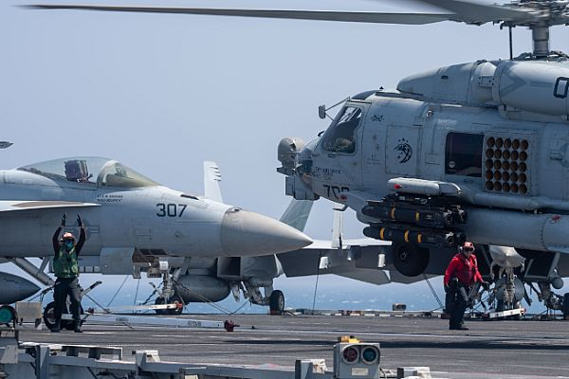
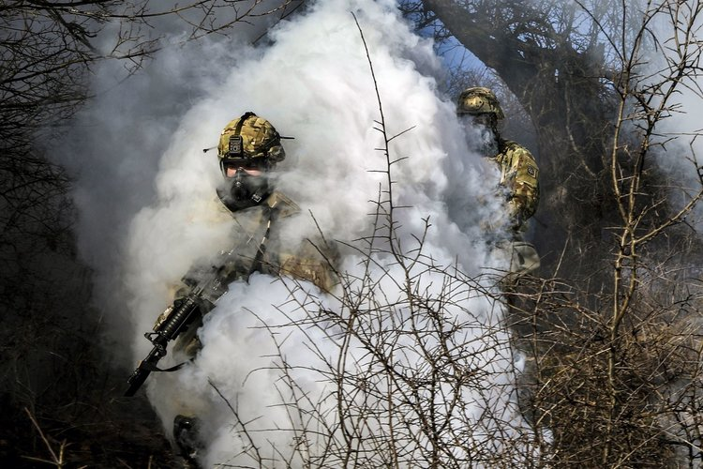
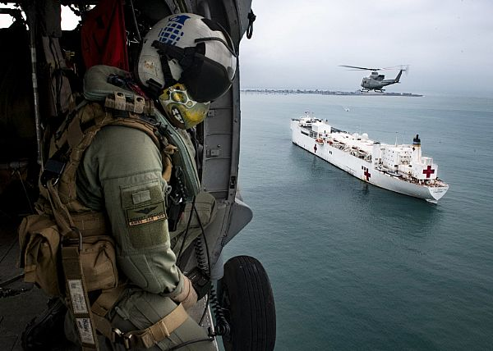
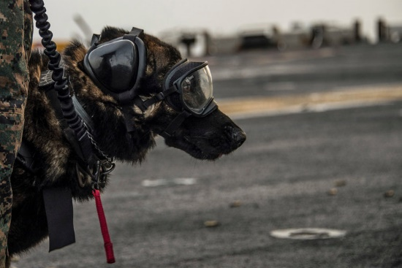
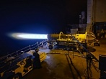
Today’s Operating Environment

Slide 7
Aviation Life Support Systems Challenges
Mission lengths have doubled
Aircrew workloads have significantly increased
Aircrew & troops are carrying mission gear loads that exceed seat designs
Aircraft environments are getting louder
Platform airframe Oxygen provision systems have aged
New threats have materialized (dazzling, degraded visual environments

Slide 8
Collaboration is Key to Program Success
Ensure synergy between the Program Office and Industry representatives
Incorporate Industry comments into the development process
Communicate interoperability and open standards
Communicate program requirements and schedules
Gain a better understanding of Industry technologies and developments
Provide updates to Industry on program requirements and acquisitions

Slide 9
Industry-Government Partnership
Going Forward….
Communicate early & often
Define / Clarify Government intent
Reduce cycle time / feedback loops
Deliver capability with greater speed

